Slide 1
MDM Troubleshooting

Slide 2
AGENDA
Log Files
Known issue troubleshooting

Slide 3
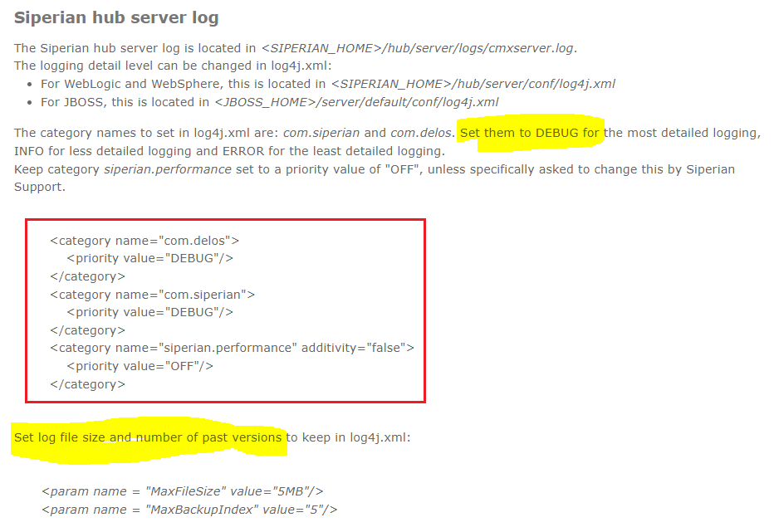
Log4j.xml
DEBUG , INFO, ERROR Mode
MDM
Troubleshooting:

Slide 4
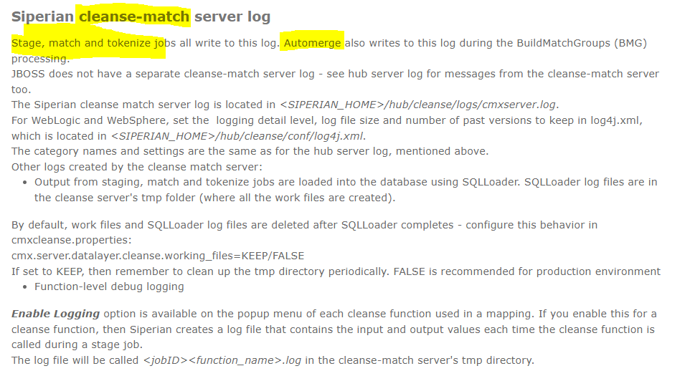
Cleanse Log
MDM
Troubleshooting:

Slide 5
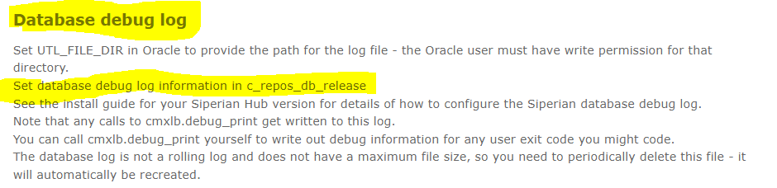
Database Debug Log
MDM
Troubleshooting:

Slide 6
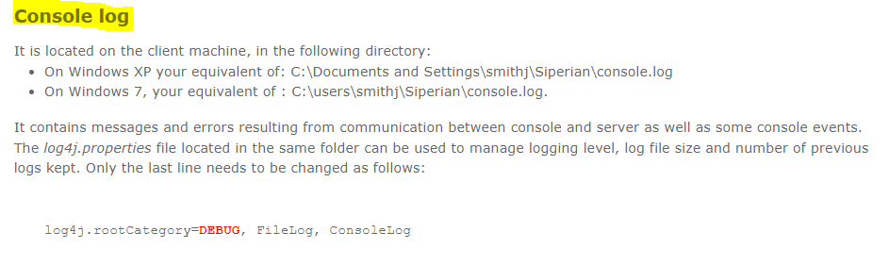
Console Log
MDM
Troubleshooting:

Slide 7
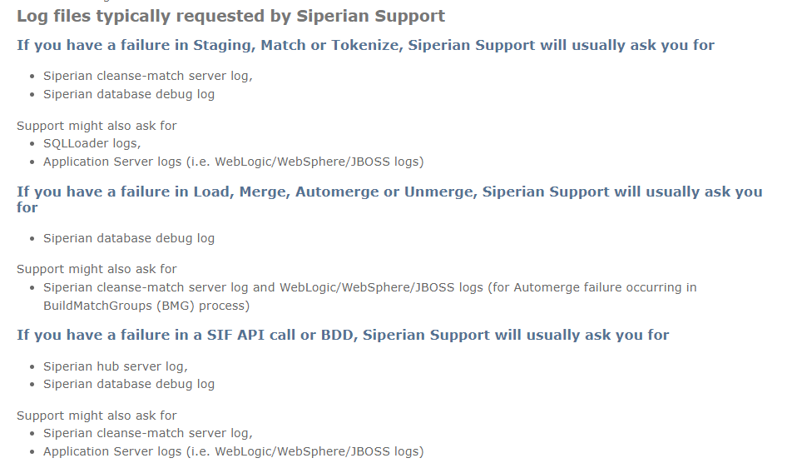
Logs
MDM
Troubleshooting:

Slide 8
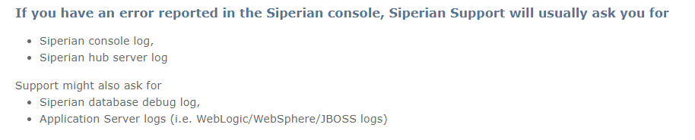
Logs
MDM
Troubleshooting:

Slide 9
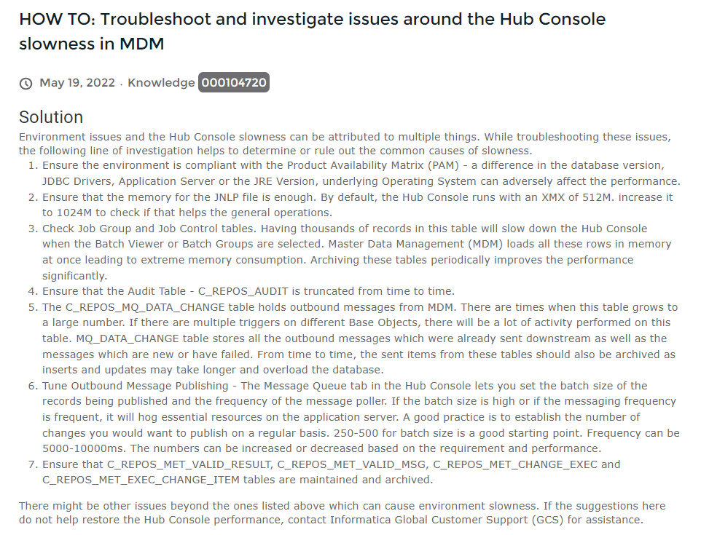
Logs
MDM
Troubleshooting:

